Slide 1
Apache Ambari Overview
Nitiraj Rathore
Pallav Kulshreshtha
April 2017

Slide 2
Agenda
Background, Release History
Ambari Alerts and Metrics
Ambari Blueprints
Security Setup (Kerberos, RBAC)
Automated Cluster Upgrade
Extensibility: Stacks and Views
What’s New and Next
Demo

Slide 3
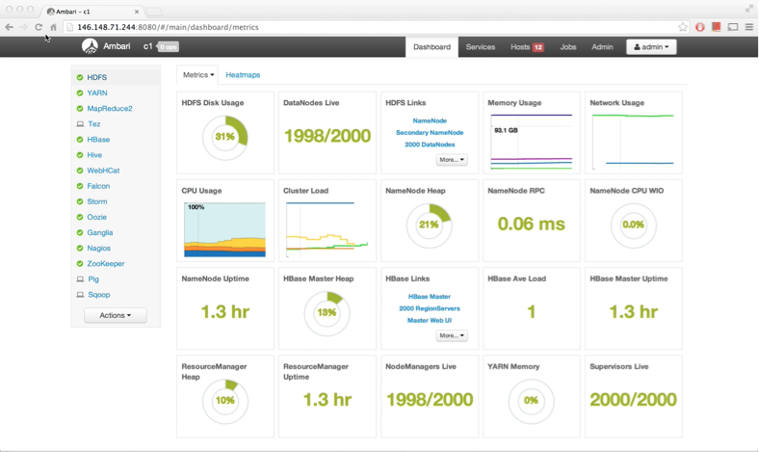
What is Apache Ambari?
A completely open source management platform for provisioning, managing, monitoring and securing Apache Hadoop clusters. Apache Ambari takes the guesswork out of operating Hadoop.

Slide 4
Ambari Recent Releases
Ambari 2.2.0
Dec 2015
Ambari 2.2.2
Apr 2016
Ambari 2.4.0 GA
Aug 2016
Ambari 2.5.0 GA
April 2017
Introduced Grafana
Introduced
Log Search TP
Introduced
Hive LLAP GA
Introduced Express Upgrade

Slide 5
Ambari Alerts

Slide 6
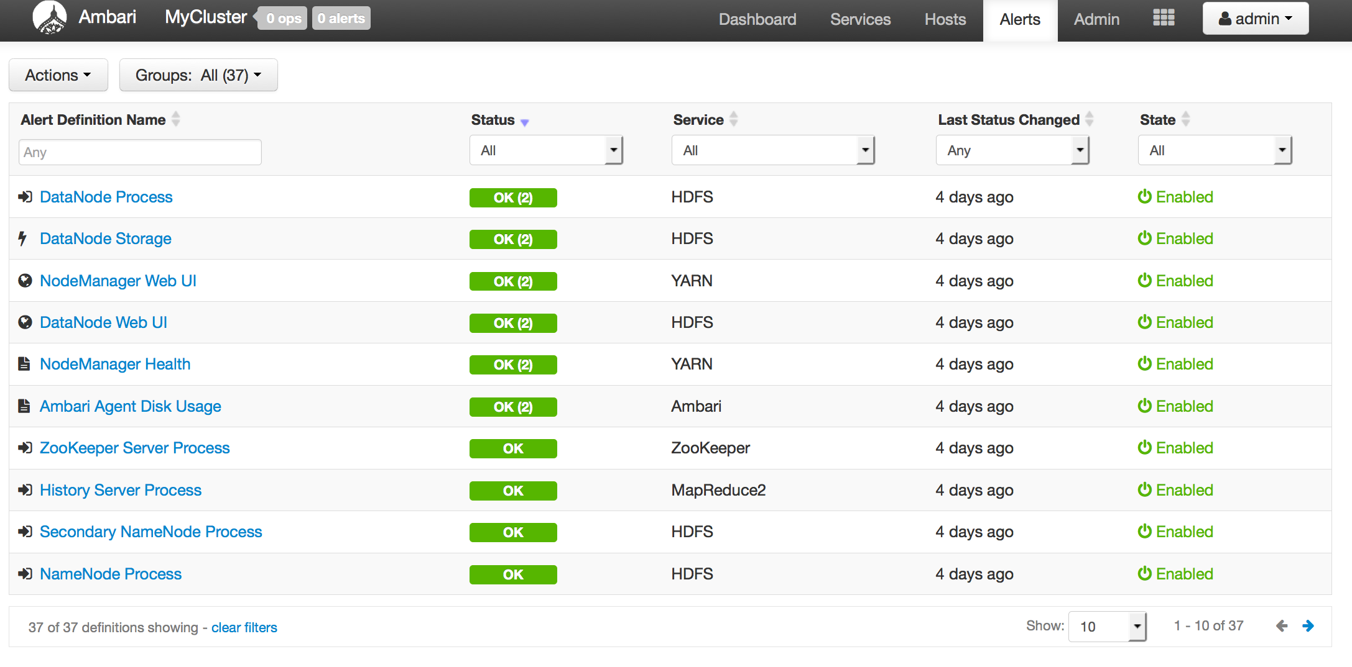
Full Visibility into Cluster Health
Centralized management of Health Alerts
Pre-defined alerts, configured by default on cluster install

Slide 7
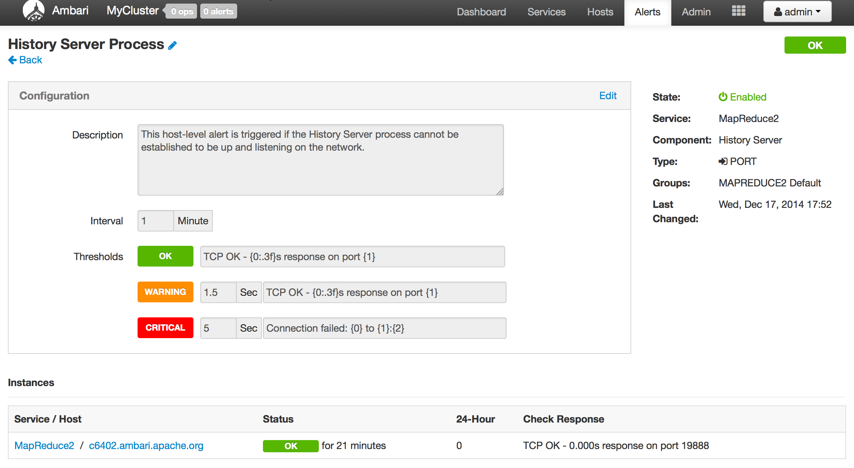
Customizing Alerts
Control thresholds, check intervals and response text
Notes:
What: Create and manage multiple notification targets
Control who gets notified when
Why: Filter by severity
Send only certain notifications to certain targets based on severity
How: Control dispatch method
Support for EMAIL + SNMP

Slide 8
Configuring the Check Count
Set globally for all alerts, or override for a specific alert
Global Setting
Alert Override

Slide 9
Ambari Alerting System
User creates or modifies cluster
Ambari reads alert definitions from Stack
Ambari sends alert definitions to Agents and Agent schedules instance checks
Agents reports alert instance status in the heartbeat
Ambari responds to alert instance status changes and dispatches notifications (if applicable)
email
snmp
5
Ambari
Server
1
3
Ambari
Agent(s)
4
2
Stack definition
alerts.json
Notes:
There are REST APIs for alerts.

Slide 10
Ambari Metrics

Slide 11
Ambari Metrics
Built using Hadoop technologies
Three components: Metrics Collector, Metrics Monitors, Grafana
Phoenix
ATS
HBase
Local Filesystem or HDFS

Slide 12
Metrics Collection
Metric Monitors send system-level metrics to Collector
Sinks send Hadoop-level metrics to Collector
Metrics Collector service stores and aggregates metrics
Ambari exposes REST API for metrics retrieval
Ambari
Server
Metrics Collector
4
3
1
2
Metrics Monitor
Sink(s)
Metrics Monitor
Sink(s)
Metrics Monitor
Sink(s)
Host1
Host1
Hosts

Slide 13
Ambari Metrics + Grafana: Introduced with Ambari 2.2
Highlights
List of Dashboards widgets
Including Grafana as a “Native UI” for Ambari Metrics
Including pre-build Dashboards
Supports configuring for HTTPS
System Home, Servers
HDFS Home, NameNodes, DataNodes
YARN Home, Applications, Job History Server
HBase Home, Performance, Misc

Slide 14
Ambari Blueprints

Slide 15
Before Ambari
Manual Installation
Manual configuration
Manual distribution of configuration
XML
XML
XML

Slide 16
Ambari Blueprints
Two primary goals of Ambari Blueprints:
Provide API-driven deployments based on self-contained cluster description
Ability to export a complete cluster description of a running cluster
Blueprints contain cluster topology and configuration information
Enables interesting use cases between physical and virtual environments

Slide 17
Ambari Stacks + Blueprints Together
Stack Definition
Component Layout & Configuration
BLUEPRINT
BLUEPRINT
HOSTS
CLUSTER
INSTANTIATE

Slide 18
Blueprints API
BLUEPRINT
1
POST /blueprints/my-blueprint
CLUSTER
CREATION
TEMPLATE
2
POST /clusters/MyCluster

Slide 19
Example: Single-Node Cluster
BLUEPRINT
Description
Single-node cluster
Use HDP 2.2 Stack
HDFS + YARN + MR2
Everything on c6401
{
"configurations" : [
{
”hdfs-site" : {
"dfs.namenode.name.dir" : ”/hadoop/nn"
}
}
],
"host_groups" : [
{
"name" : ”uber-host",
"components" : [
{ "name" : "NAMENODE” },
{ "name" : "SECONDARY_NAMENODE” },
{ "name" : "DATANODE” },
{ "name" : "HDFS_CLIENT” },
{ "name" : "RESOURCEMANAGER” },
{ "name" : "NODEMANAGER” },
{ "name" : "YARN_CLIENT” },
{ "name" : "HISTORYSERVER” },
{ "name" : "MAPREDUCE2_CLIENT” }
],
"cardinality" : "1"
}
],
"Blueprints" : {
"blueprint_name" : "single-node-hdfs-yarn",
"stack_name" : "HDP",
"stack_version" : "2.2"
}
}
CLUSTER CREATION TEMPLATE
{
"blueprint" : "single-node-hdfs-yarn",
"host_groups" :[
{
"name" : ”uber-host",
"hosts" : [
{
"fqdn" : "c6401.ambari.apache.org”
}
]
}
]
}

Slide 20
Security Setup

Slide 21
Authentication
Kerberos
LDAP/AD
PEM/Local Authentication
Custom

Slide 22
Kerberos
Hadoop Cluster
Kerberos is used to secure the Components in the cluster. Kerberos identities are managed via “keytabs” on the Component hosts.
Service Component A
Service Component B
Service Component C
Service Component D
keytab
keytab
keytab
keytab
Principals for the cluster are managed in the KDC.
Service Component X
Service Component X
Service Component X
Service Component X
KDC
keytab
keytab
keytab
keytab
Notes:
User provides KDC Admin Account credentials to Ambari
Ambari connects to KDC, creates principals (Service and Ambari) needed for cluster
Ambari generates keytabs for the principals
Ambari distributes keytabs to Ambari Server and cluster hosts
Ambari discards the KDC Admin Account credentials

Slide 23
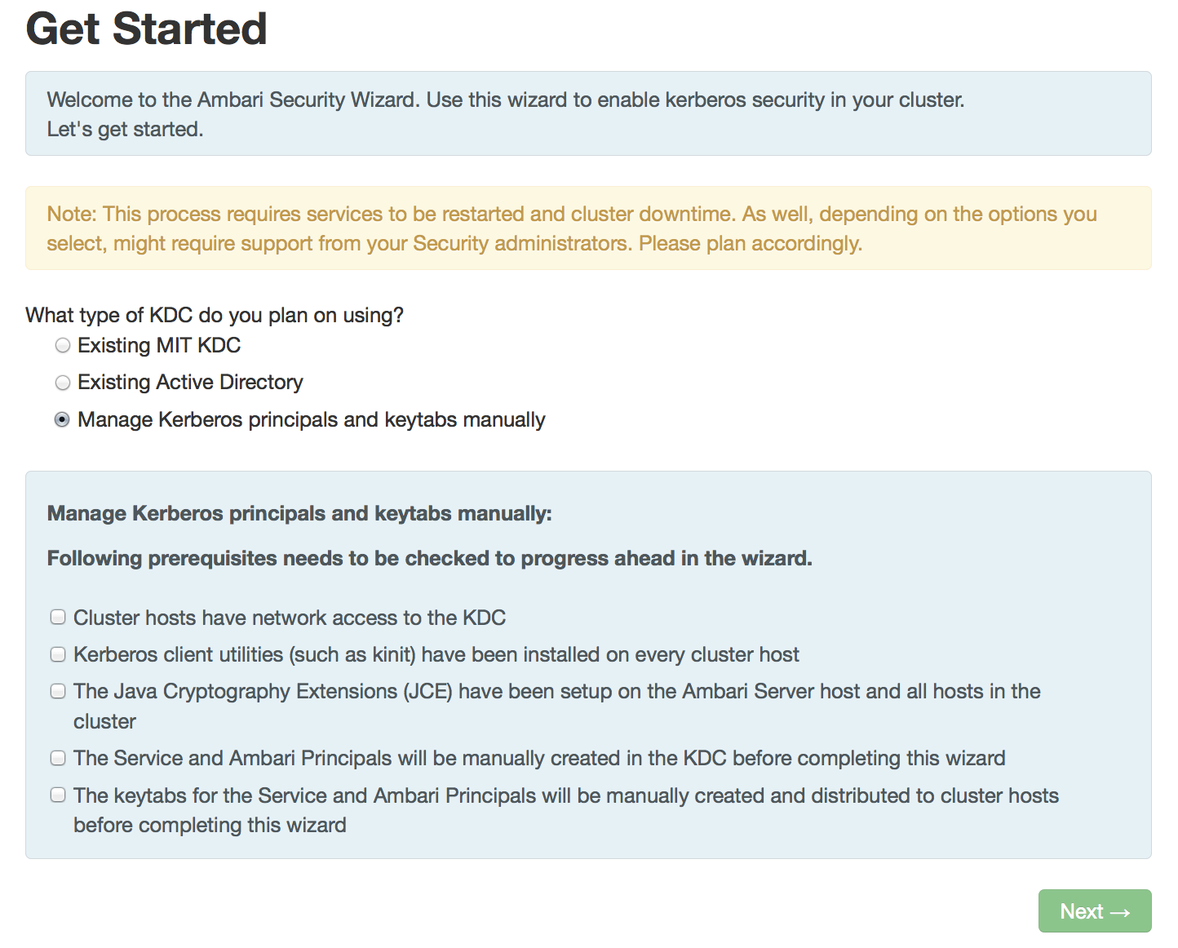
Automated Kerberos Security Setup
Wizard Driven Simplify the experience of enabling and managing Kerberos security
Automated and Manual Options Critical for today’s enterprise
Works with Existing Kerberos Infrastructure Such as Active Directory and MIT KDC

Slide 24
Role-Based Access Control (RBAC)

Slide 25
Role-Based Access Control
Use “roles” for more granular division of control for cluster operations
Old Permission | New Role | Notable Permissions
Operator | Cluster Administrator | Full operational control, including upgrades. Ambari Admins are implicitly granted this Role.
 | Cluster Operator | Adding and removing hosts.
 | Service Administrator | Manage configurations, move components.
 | Service Operator | Service stop and start and service-specific operations such as HDFS Rebalance.
Read-Only | Cluster User | View cluster service and host information.
Note: Users flagged as “Ambari Admins” are implicitly granted Cluster Administrator permission.

Slide 26
Managing Cluster Roles
Assign roles to users or groups
Manage roles in Block or List View layouts

Slide 27
Managing Cluster Roles
View users or groups
Change current role assignment

Slide 28
Automated Cluster Upgrade

Slide 29
Automated Cluster Upgrade Terminology
Rolling Upgrade
Orchestrates the cluster upgrade in an order that is meant to preserve cluster operation and minimize service impact. The tradeoff is more stringent prerequisites and a longer upgrade time.
Express Upgrade
Orchestrates the cluster upgrade in an order that will incur cluster downtime. This method has less stringent prerequisites but completes in a faster upgrade time.
Notes:
Key Difference is there is a downtime in Express Upgrade as all the services are down once.

Slide 30
Automated Upgrade: Rolling or Express Choice
Check Prerequisites
Prepare
Register + Install
Perform Upgrade
Finalize
Review the prerequisites to confirm your cluster configuration is ready for upgrade
Perform the preparation steps, which include making backups of critical cluster metadata.
Register the software repository and install the target version on the cluster.
Perform the upgrade. The steps depend on upgrade method: Rolling or Express.
Finalize the upgrade, making the target version the current version.
Notes:
Backup of critical cluster metadata
Change the symlinks

Slide 31
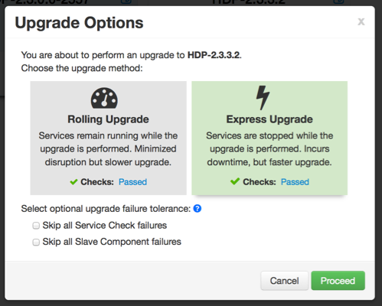
Automated Upgrade Choice: Rolling or Express

Slide 32
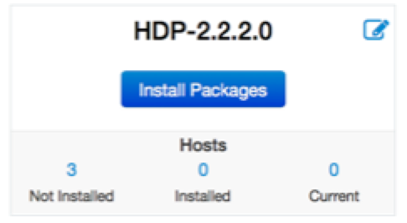
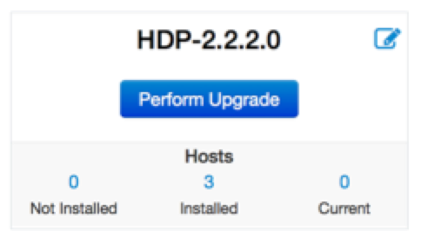
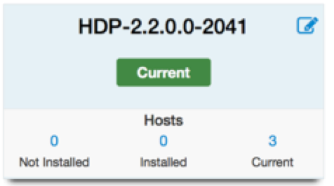
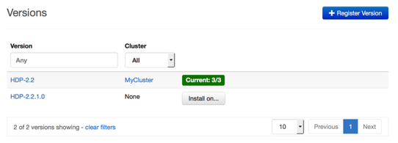
Automated Upgrade: High-Level Process
Register
Install
Perform
Upgrade
Finalize

Slide 33
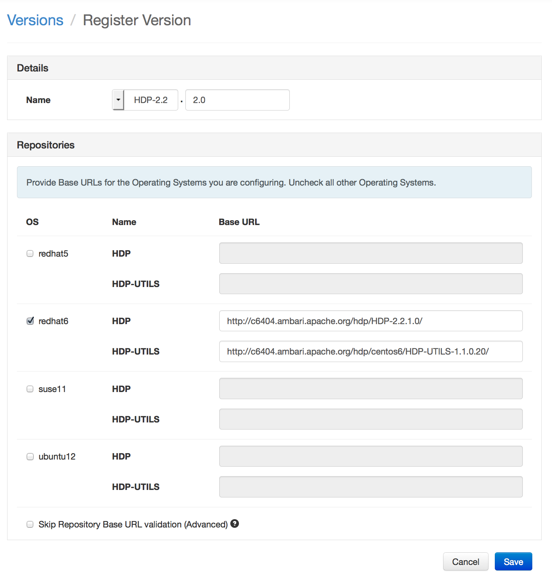
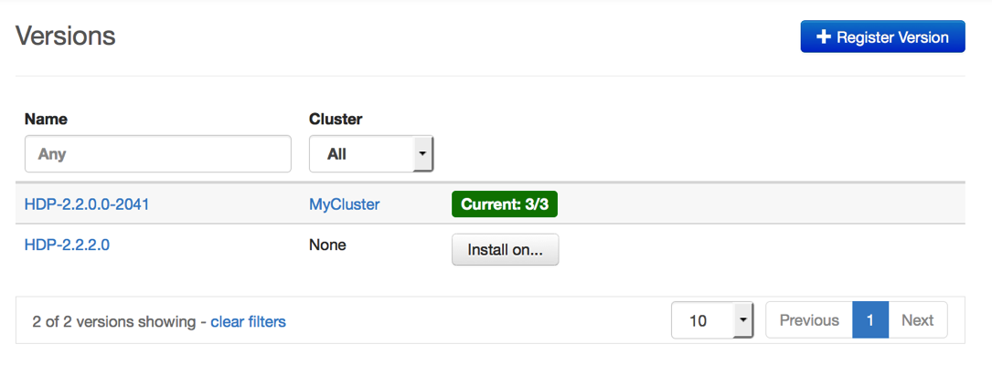


Register New Version
Register
Install
Perform
Upgrade
Finalize
Register new version with Ambari
Provide the Repository Base URLs for new version

Slide 34
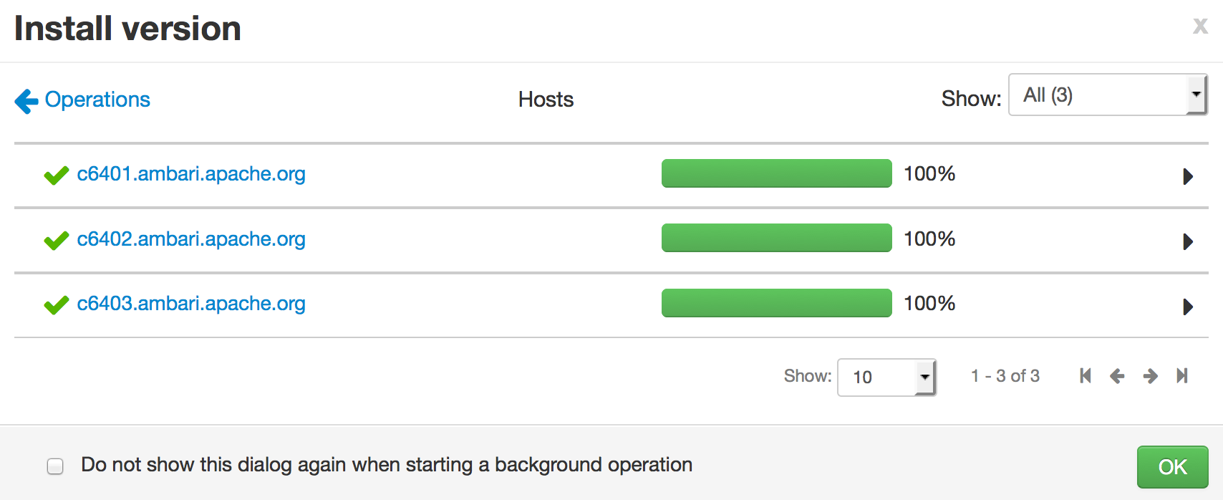
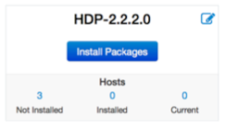
Install Packages
Register
Install
Perform
Upgrade
Finalize
Click “Install Packages” to start the install of the version across hosts

Slide 35
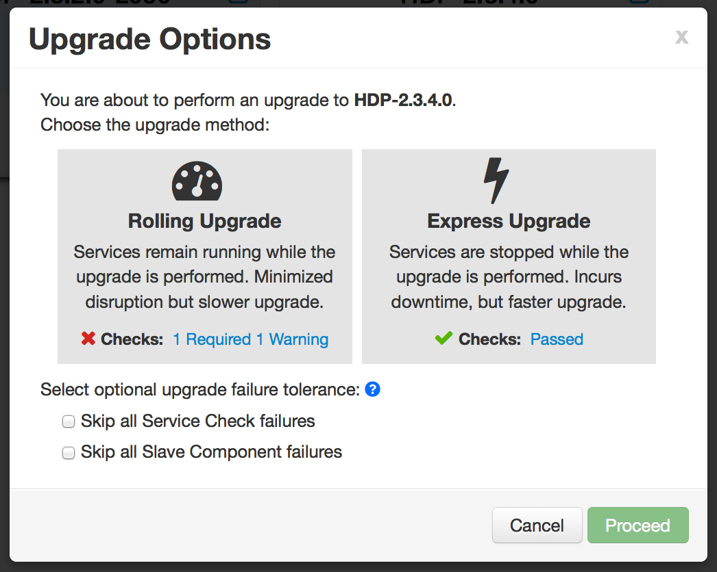
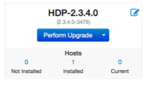
Upgrade Choice
Register
Install
Perform
Upgrade
Finalize
Upgrade Options dialog gives you a choice of method: Rolling or Express

Slide 36
Upgrade Choice: Rolling or Express
Register
Install
Perform
Upgrade
Finalize
Checks indicate if an option is available

Slide 37
Upgrade Choice: Rolling or Express
Register
Install
Perform
Upgrade
Finalize
New options to handle failures

Slide 38
Upgrade Tolerance Options
Register
Install
Perform
Upgrade
Finalize
Tolerance Option | Description
Skip all Service Check failures | Ambari will automatically skip any Service Check failures and complete the task without requiring user intervention to continue. After all the Service Checks have run in a task, you will be presented with summary of the failures and an option to continue the upgrade or pause.
Skip all Slave Component failures | Ambari will automatically skip any Slave Component failures and complete the task of upgrading Slave components without requiring user intervention to continue. After all Slave Components have been upgraded, you will be presented with a summary of the failures and an option to continue the upgrade or pause.

Slide 39
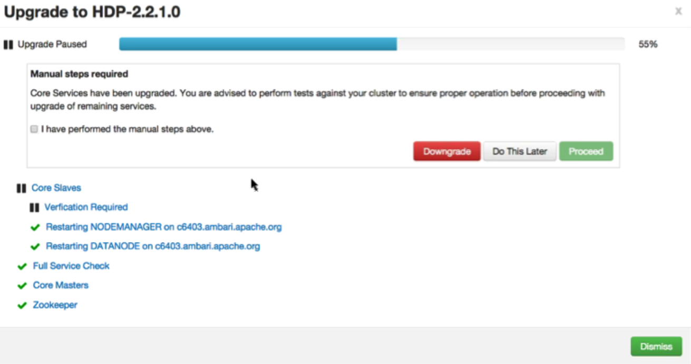
Wizard Driven Experience
Register
Install
Perform
Upgrade
Finalize
With verification and validation

Slide 40
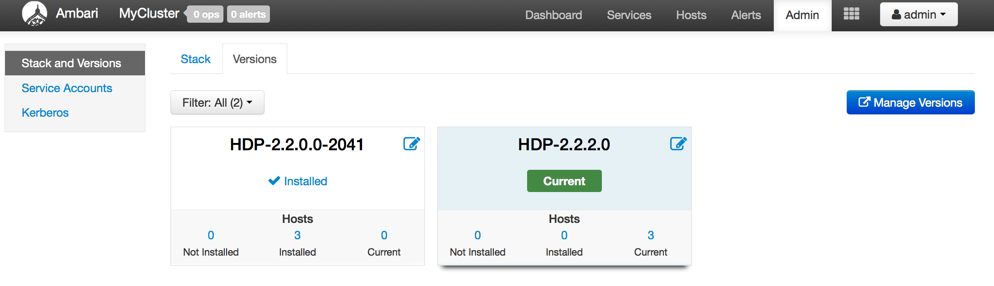
Rolling Upgrade – Success!
Register
Install
Perform
Upgrade
Finalize

Slide 41
Ambari Extensibility

Slide 42
Extensibility Features
Stacks
To add new Services (ISV or otherwise) beyond Stack
To customize a Stack for customer specific environments
Views
To extend and customize the Ambari Web UI
Add new capabilities, customize existing capabilities

Slide 43
Anatomy of Ambari Extension Points
Ambari
Web
Ambari
Server
Ambari
Agent
Ambari
Agent
Ambari
Agent
Stacks
js
java
Stacks
python
Stacks
Ambari Views
Ambari Stacks

Slide 44
Ambari Stacks

Slide 45

Ambari Stacks
Defines a consistent Stack lifecycle interface that can be extended
Encapsulates Stack Versions, Services, Components, Dependencies, Cardinality, Configurations, Commands
Dynamically add Stack + Service definitions
AMBARI
{rest}
HDFS
YARN
MR2
Stacks
Hive
HBase
Oozie
<ambari-web>
Falcon
Pig
Storm

Slide 46
Stack Terminology
Term | Definition | Examples
STACK | Defines a set of Services, where to obtain the software packages and how to manage the lifecycle. | HDP-2.5, HDP-2.6
SERVICE | Defines the Components that make-up the Service. | HDFS, YARN, HIVE, SPARK
COMPONENT | The building-blocks of a Service, that adhere to a certain lifecycle. | NAMENODE, DATANODE, OOZIE_SERVER
CATEGORY | The category of Component. | MASTER, SLAVE, CLIENT

Slide 47
Stack Mechanics
Stacks define Services + Repos
What is in the Stack, and where to get the bits
Each Service has a definition
What Components are part of the Service
Each Service has defined lifecycle commands
start, stop, status, install, configure
Lifecycle is controlled via command scripts
Ability to define “custom” commands
AMBARI
SERVER
Repos
AMBARI
AGENT/S
Stack
AMBARI
AGENT/S
AMBARI
AGENT/S
Service Definitions
Command Scripts
xml
python
Notes:
Overrides any Service definitions, commands and configurations
Adds new Services specific to this Stack
Defines a set of Service definitions
Default service configurations and command scripts

Slide 48
Smart Configs

Slide 49
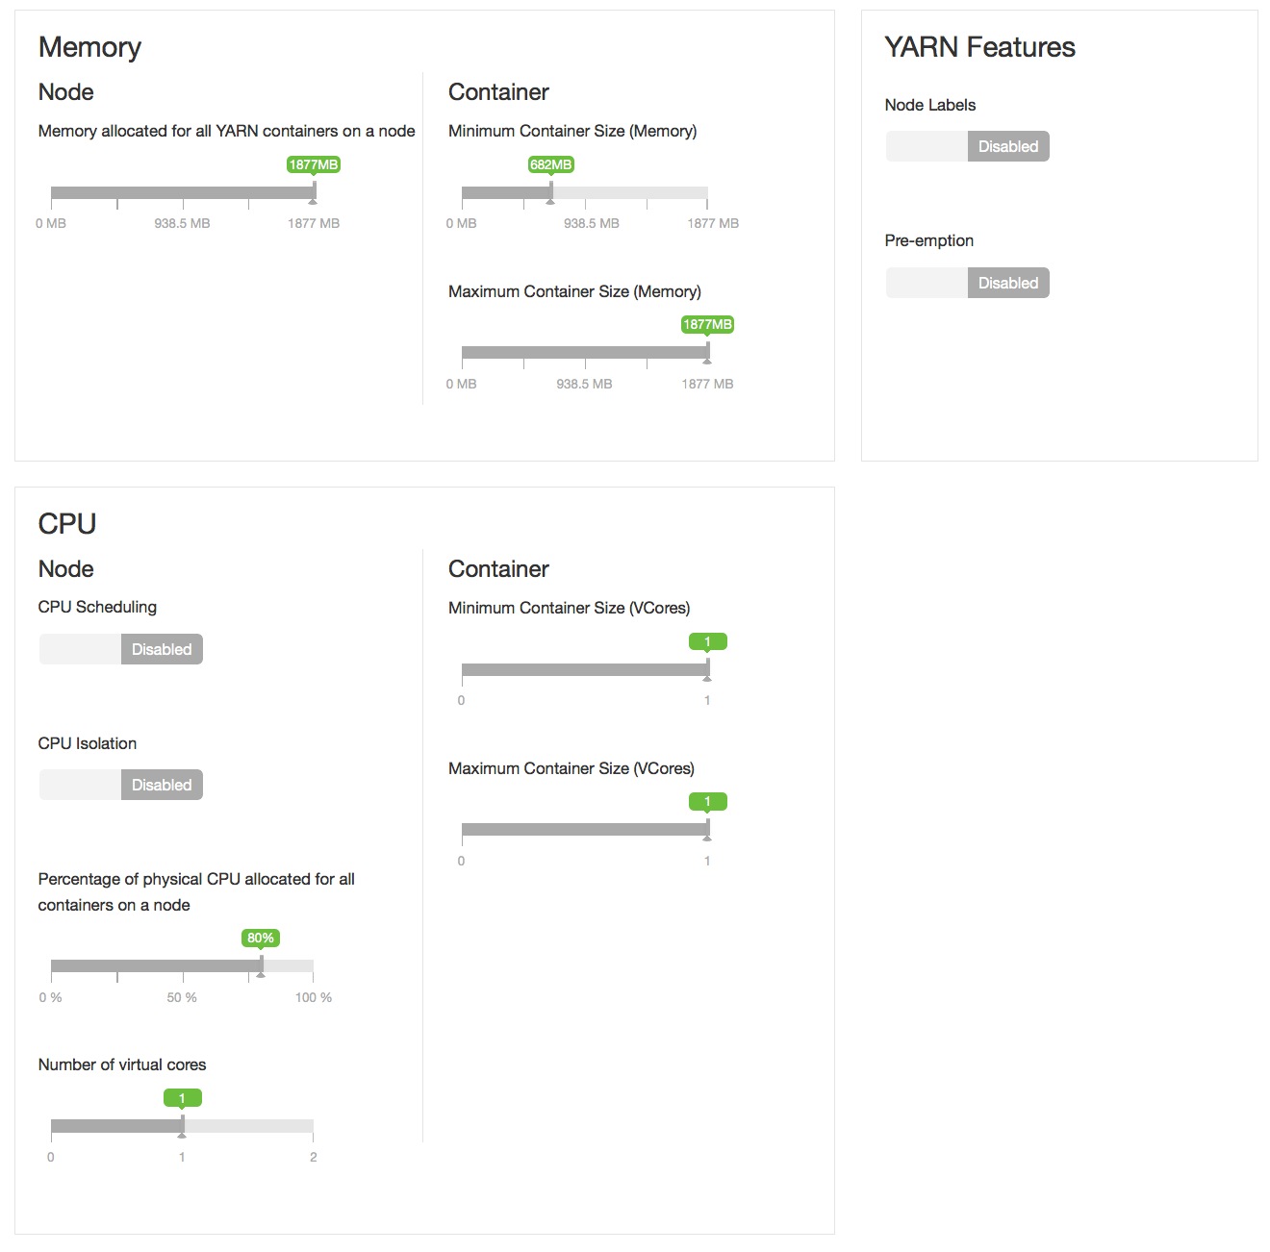
Smart Configurations
Take the guesswork out of cluster configuration
Intuitive layout and grouping of configurations
Smart UI controls to make it easier to set values
Recommendations and cross-service dependency checks
Take the guesswork out of cluster configuration
Driven by Stack definition

Slide 50
Ambari Views

Slide 51
Ambari Views Framework
Developers can extend the Ambari Web interface
Views expose custom UI features for Hadoop Services
Ambari Admins can entitle Views to Ambari Web users
Entitlements framework for controlling access to Views

Slide 52
Views Framework vs. Views
Views
Built by Hortonworks, Community, Partners
Views Framework
Core to Ambari

Slide 53
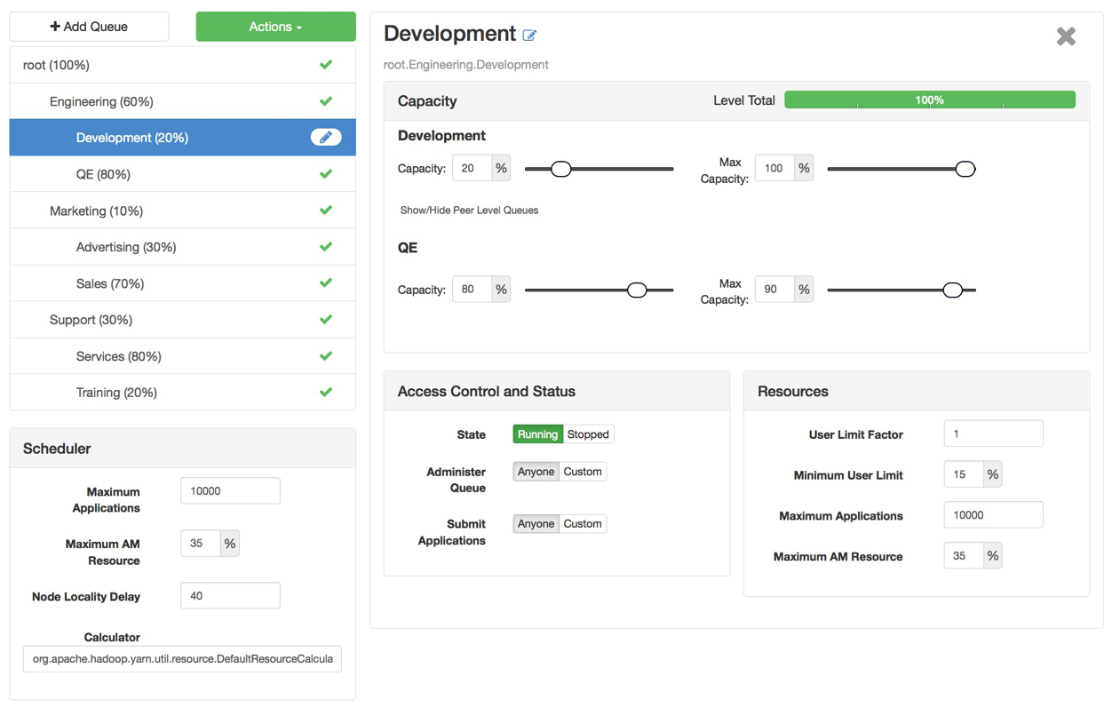
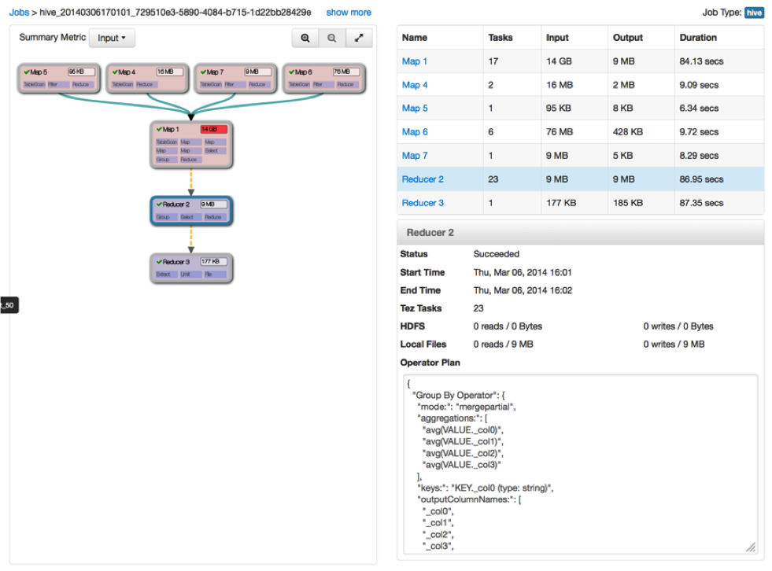
Example Views
Capacity Scheduler
“Queue Manager” View
Tez
“Jobs” View

Slide 54
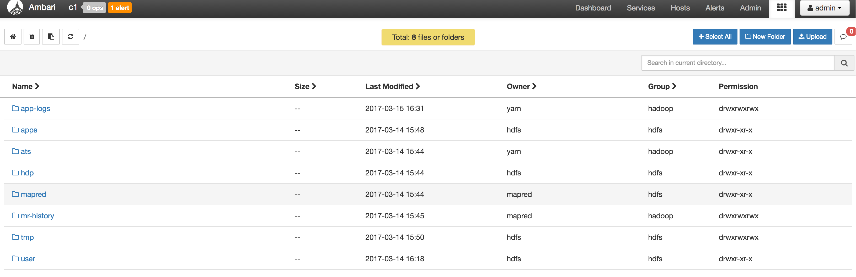
Files Views

Slide 55
Files View

Slide 56
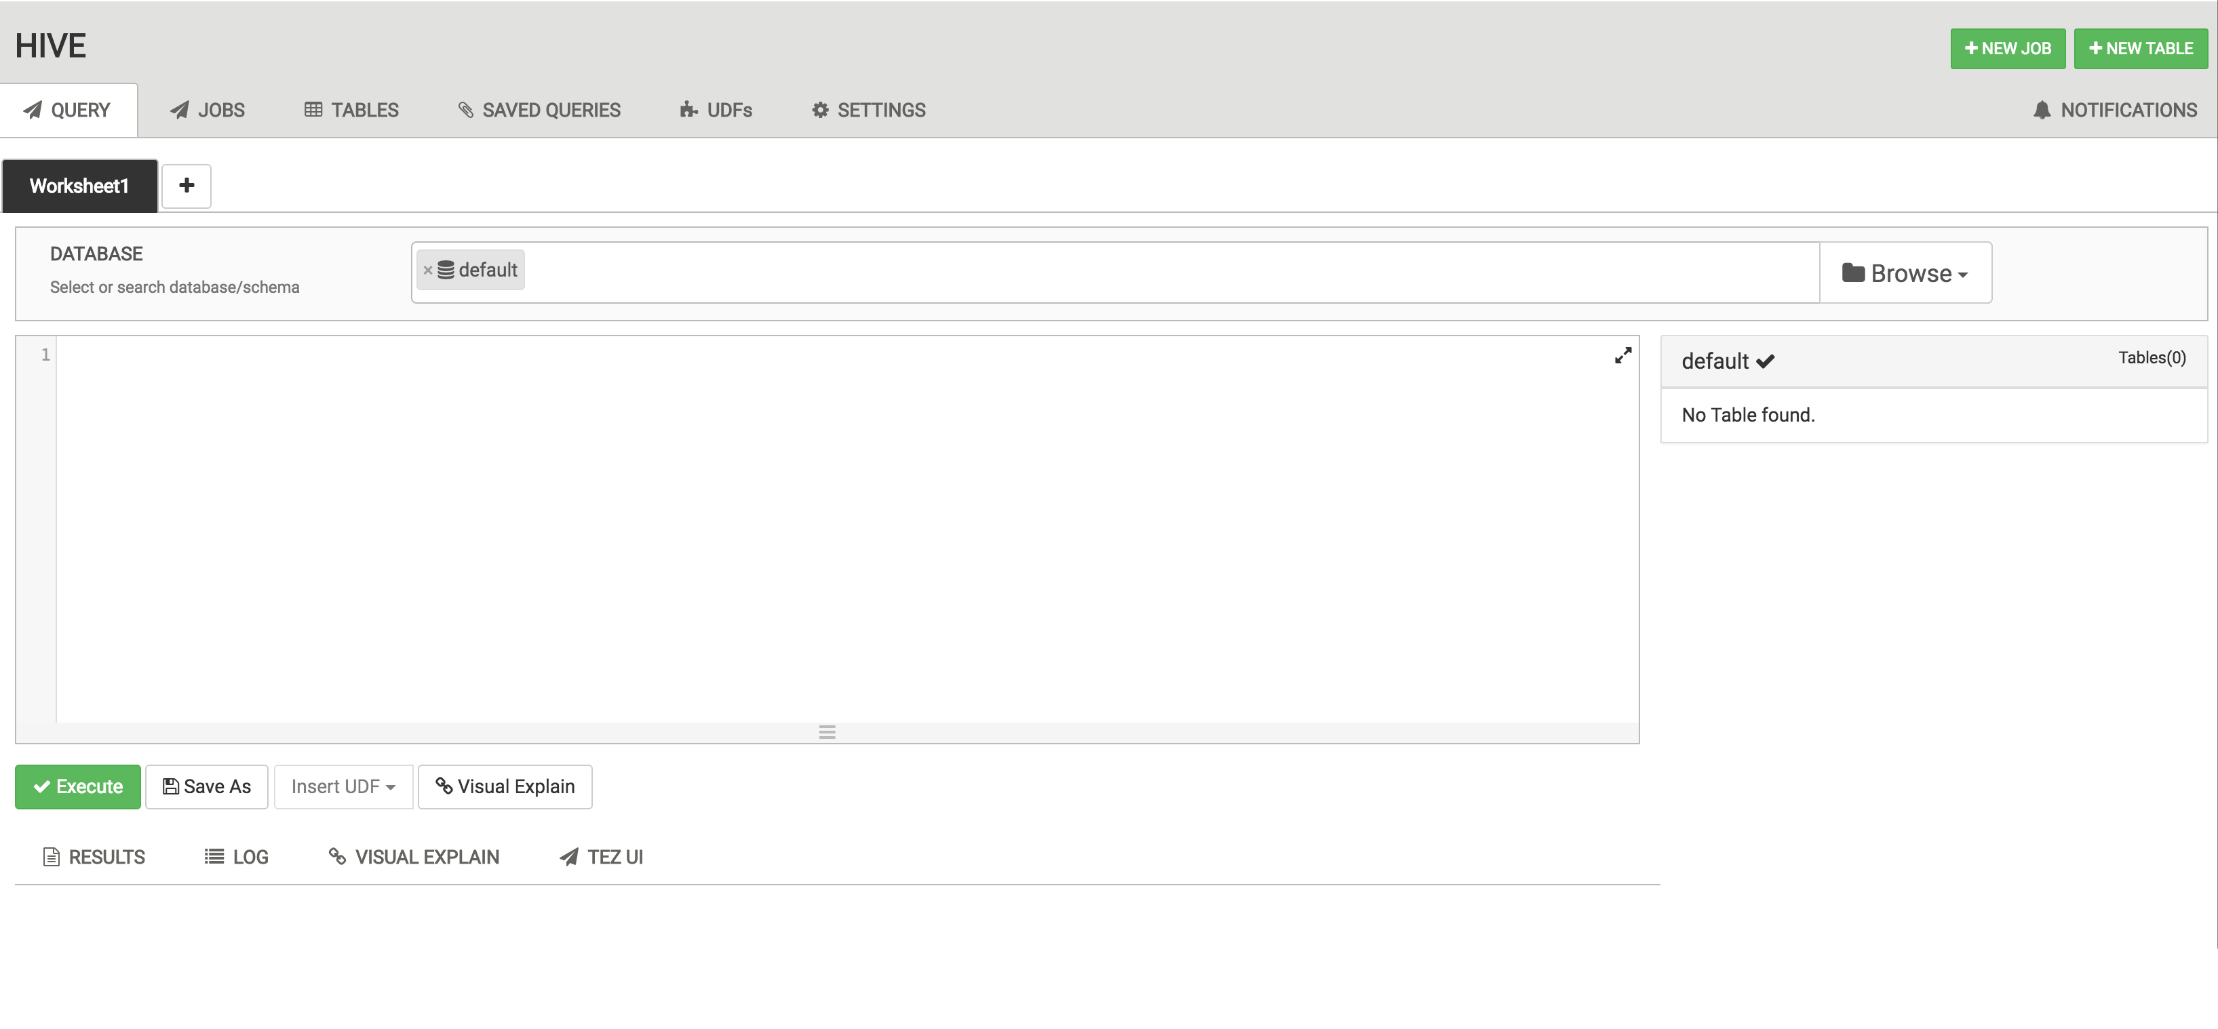
Hive 2.0 View

Slide 57
View Components
Serve client-side assets (such as HTML + JavaScript)
Expose server-side resources (such as REST endpoints)
AMBARI WEB
AMBARI SERVER
VIEW
Client-side assets
(.js, html)
VIEW
Server-side resources
(java)
Hadoop and other systems
{rest}

Slide 58
View Delivery
Develop the View (just like you would for a Web App)
Package as a View (basically a WAR)
Deploy the View into Ambari
Ambari Admins create + configuration view instance(s) and give access to users + groups
Develop
Package
Deploy
Create Instance(s)

Slide 59
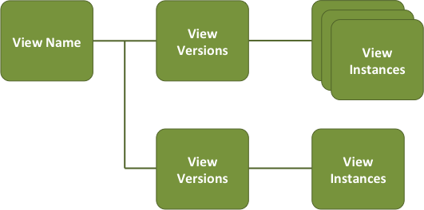
Versions and Instances
Deploy multiple versions and create multiple instances of a view
Manage accessibility and usage

Slide 60


Choice of Deployment Model
For Hadoop Operators:
Deploy Views in an Ambari Server that is managing a Hadoop cluster
For Data Workers:
Run Views in a “standalone” Ambari Server
Operators manage the cluster, may have Views deployed
Ambari
Server
HADOOP
Store & Process
Data Workers use the cluster and use a “standalone” Ambari Server for Views
Ambari
Server

Slide 61
What’s New in Ambari 2.4 and Ambari 2.5
APRIL
Core Features
Security Features
Add/Remove Journal Nodes (AMBARI-7748)
Service Auto-Start (AMBARI-2330)
Configuration Change Communication(AMBARI-19572)
HDFS TopN User & Operation Visualization (AMBARI-19320)
Download All Client Configurations(AMBARI-19275)
Built-In SNMP MIB (AMBARI-19257)
DB Inconsistency Self-Healing(AMBARI-18990)
Log Search TP Update(AMBARI-18817)
Ignore Host Pre-Check when Adding a Host (AMBARI-18817)
Operational Audit Logging (AMBARI-15241)
Role-Based Access Control (AMBARI-13977)
Automated Setup of Ambari Kerberos (AMBARI-15561)
Automated Setup of Ambari Proxy User (AMBARI-15561)
Customizable Host Reg. SSH Port (AMBARI-13450)
Views Framework Features
View URLs (AMBARI-15821), View Refresh (AMBARI-15682)
Inherit Cluster Permissions (AMBARI-16177)
Remote Cluster Registration (AMBARI-16274)

Slide 62
What’s New and Next

Slide 63
What’s Next
Modular Deployment of Services & Components
Configuration Management: Allow for configuration changes without a service restart
Configuration changes applied using rolling restart of masters
Spark integration with AMS
Support Amazon AWS KMS for storing master keys of Ranger KMS

Slide 64
Learn More About Apache Ambari
Resource | Location
Apache Ambari Project Page | http://ambari.apache.org
Ambari Project Wiki | https://cwiki.apache.org/confluence/display/AMBARI
Ambari Project JIRA | https://issues.apache.org/jira/browse/AMBARI
Stacks | https://cwiki.apache.org/confluence/pages/viewpage.action?pageId=38571133
Blueprints | https://cwiki.apache.org/confluence/display/AMBARI/Blueprints
Views | https://cwiki.apache.org/confluence/display/AMBARI/Views

Slide 65
Thank You

